Slide 1
TensorFlow tutorial
Part2
Sungjoon Choi
(sungjoon.choi@cpslab.snu.ac.kr)

Slide 2
Part1: TensorFlow tutorial
Handling images
Logistic regression
Multi-layer perceptron
Convolutional neural network

Slide 5
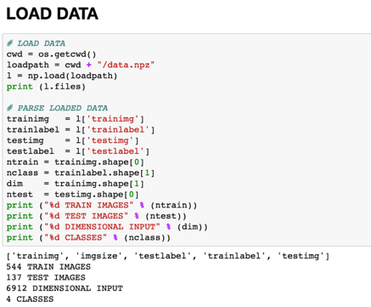
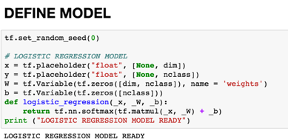
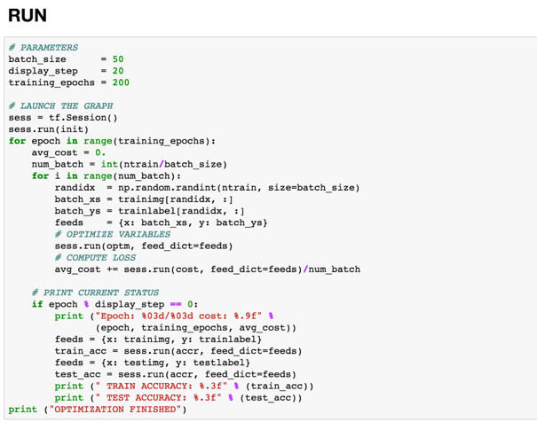
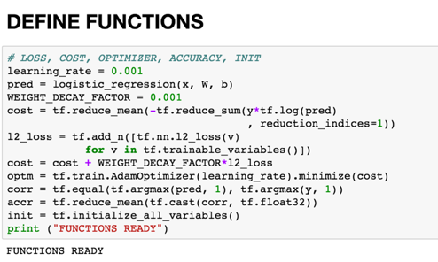
Overview
1. Load custom dataset
2. Define Logistic regression model
4. Train the model
3, Define functions

Slide 6
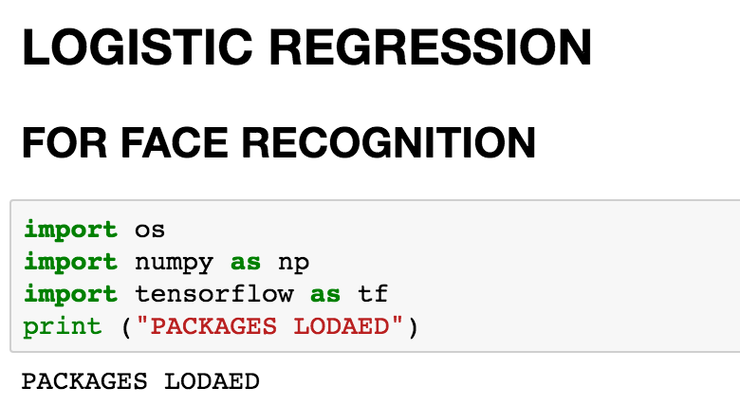
Load packages

Slide 7

Load custom dataset

Slide 8
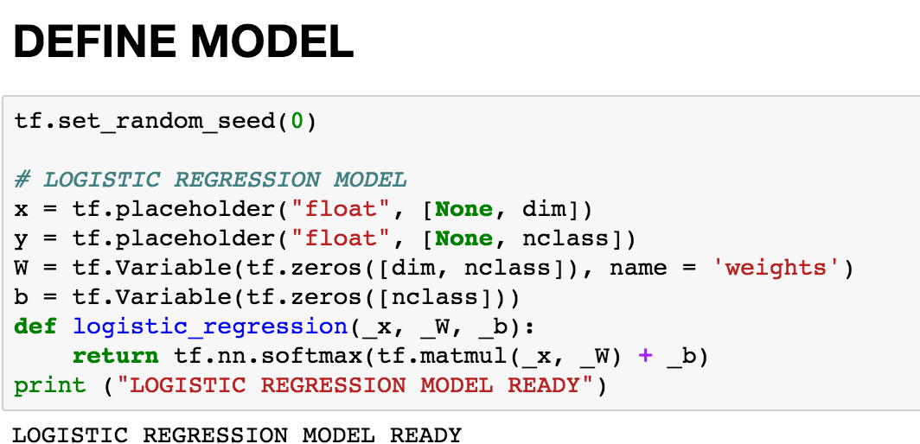
Define Logistic regression model

Slide 9

Define functions

Slide 10

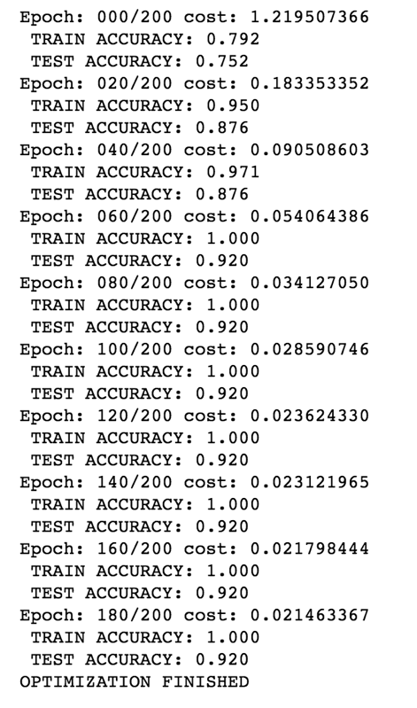
Train the model

Slide 11
Review
1. Load custom dataset
2. Define Logistic regression model
4. Train the model
3, Define functions

Slide 12
Part1: TensorFlow tutorial
Handling images
Logistic regression
Multi-layer perceptron
Convolutional neural network

Slide 14
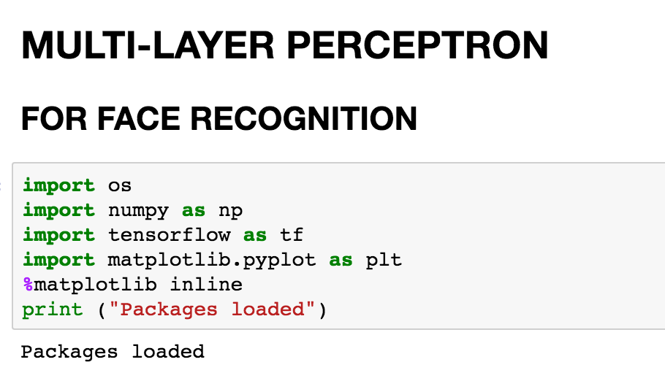
Load packages

Slide 15
Load custom dataset

Slide 16
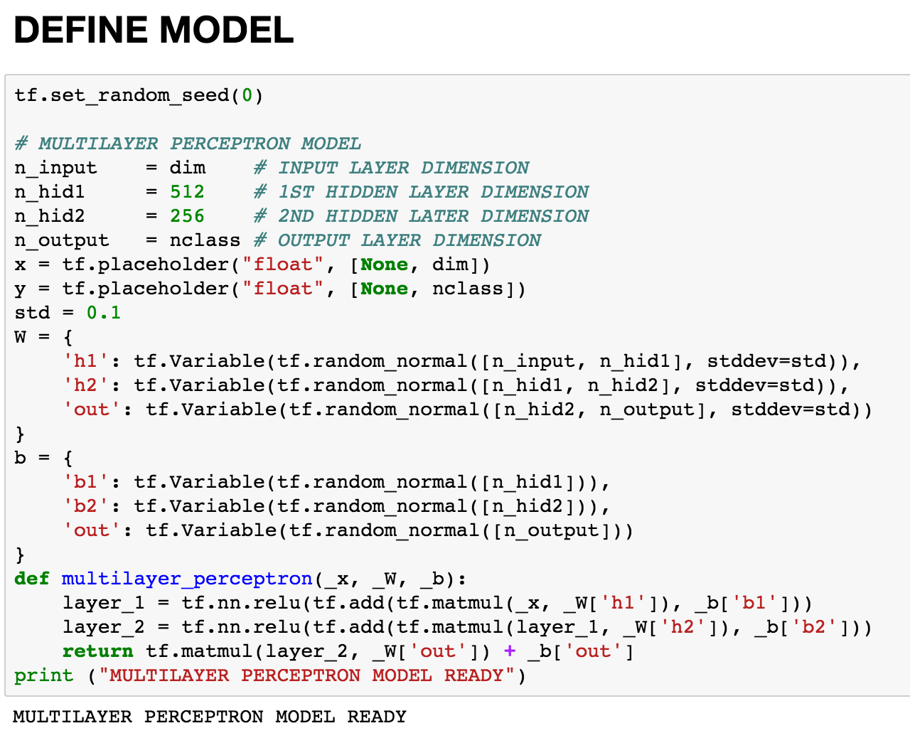
Define MLP model

Slide 17
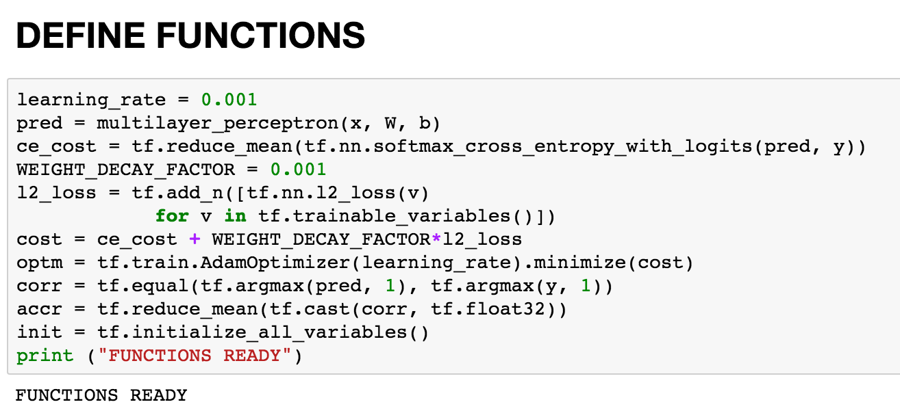
Define functions

Slide 18
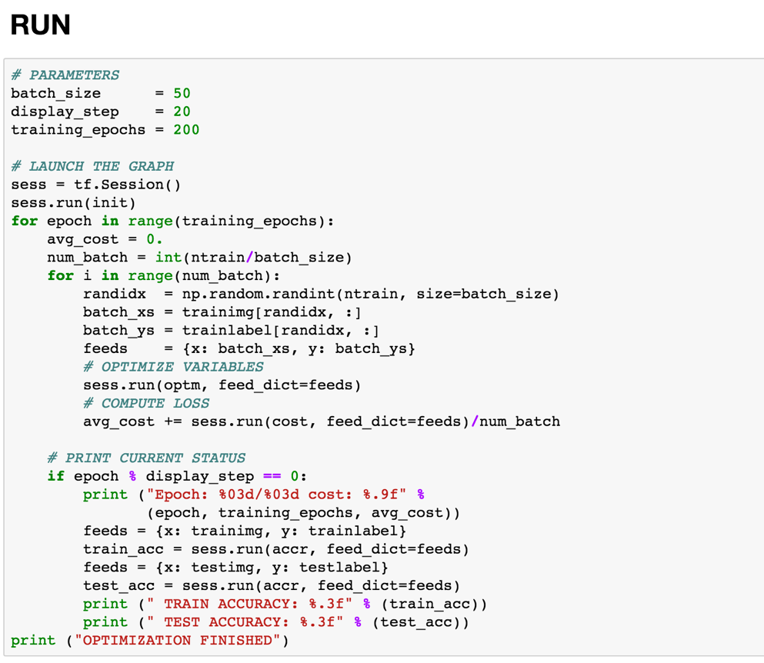
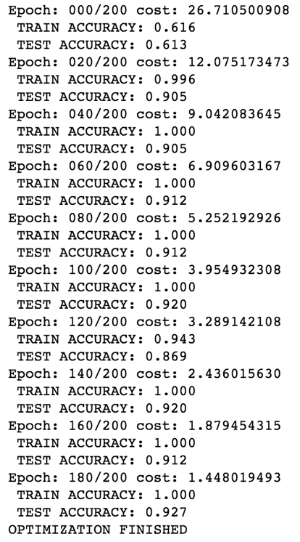
Train the model

Slide 19

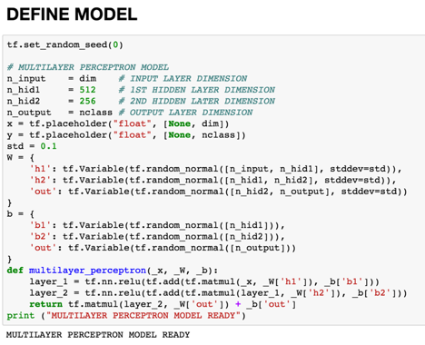
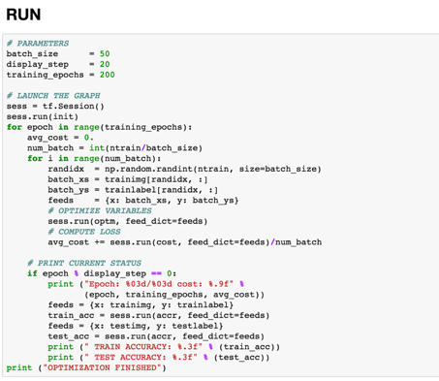
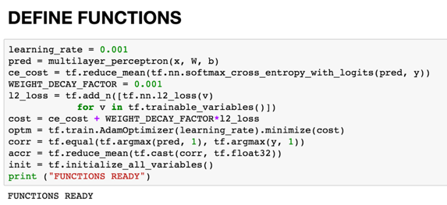
Review
1. Load custom dataset
2. Define MLP model
4. Train the model
3. Define functions

Slide 20
Part1: TensorFlow tutorial
Handling images
Logistic regression
Multi-layer perceptron
Convolutional neural network

Slide 23
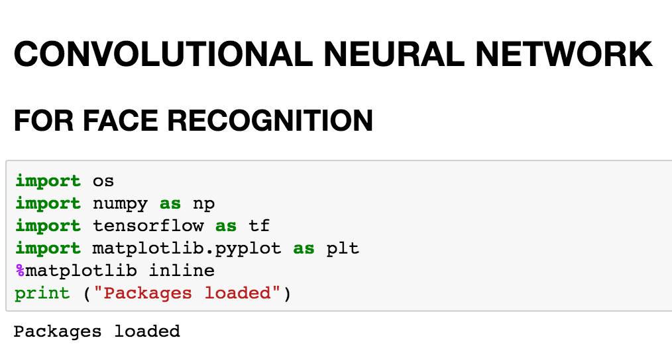
Load packages

Slide 24
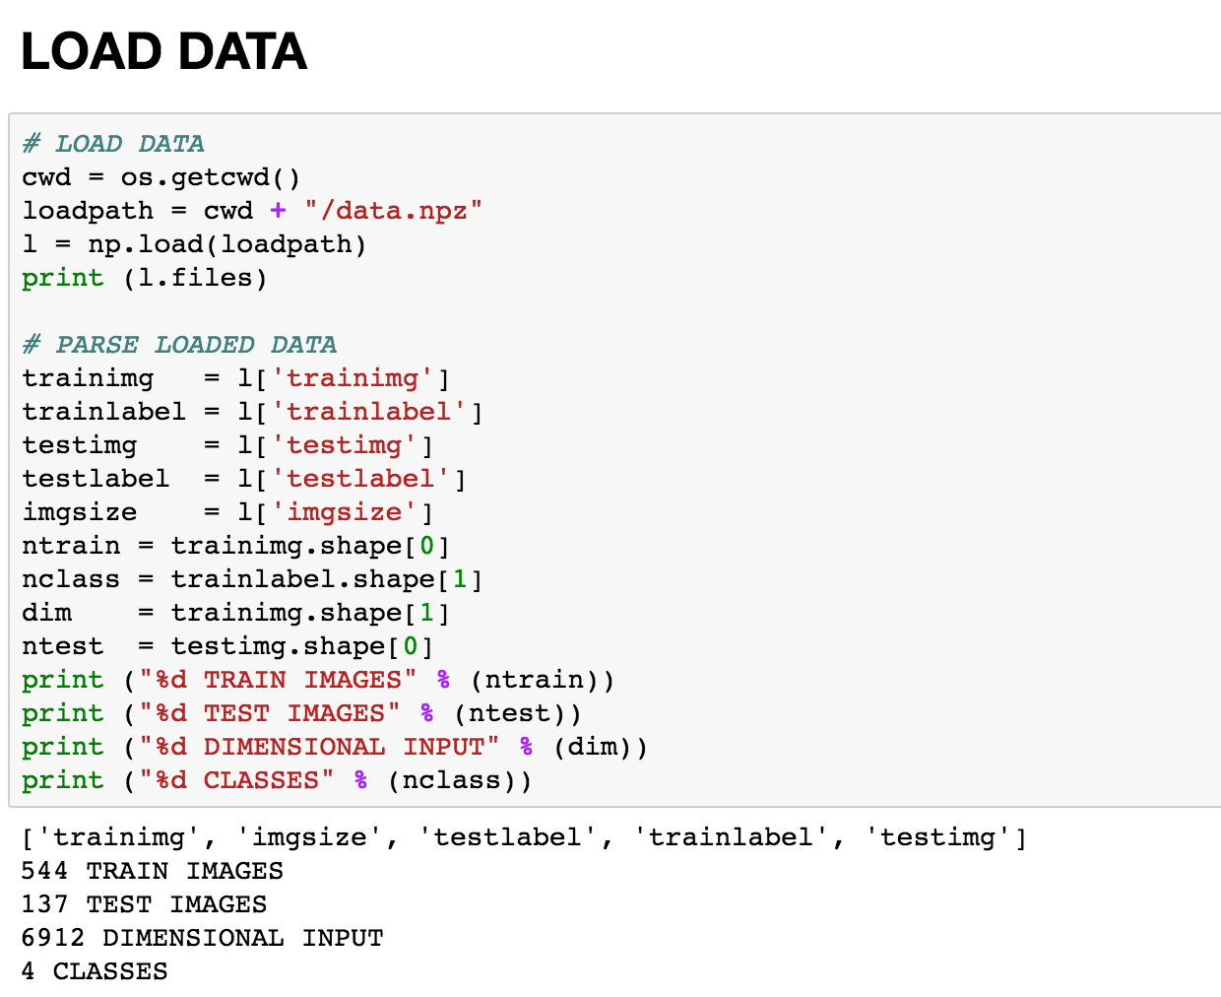
Load custom dataset

Slide 25
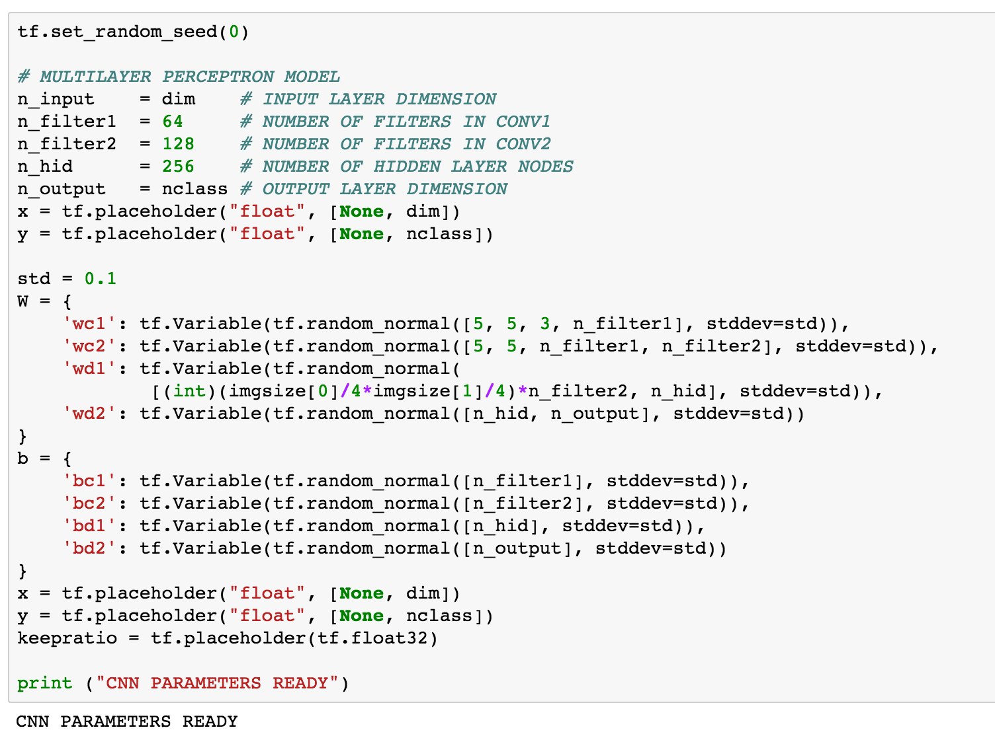
Define CNN model (1/2)

Slide 26
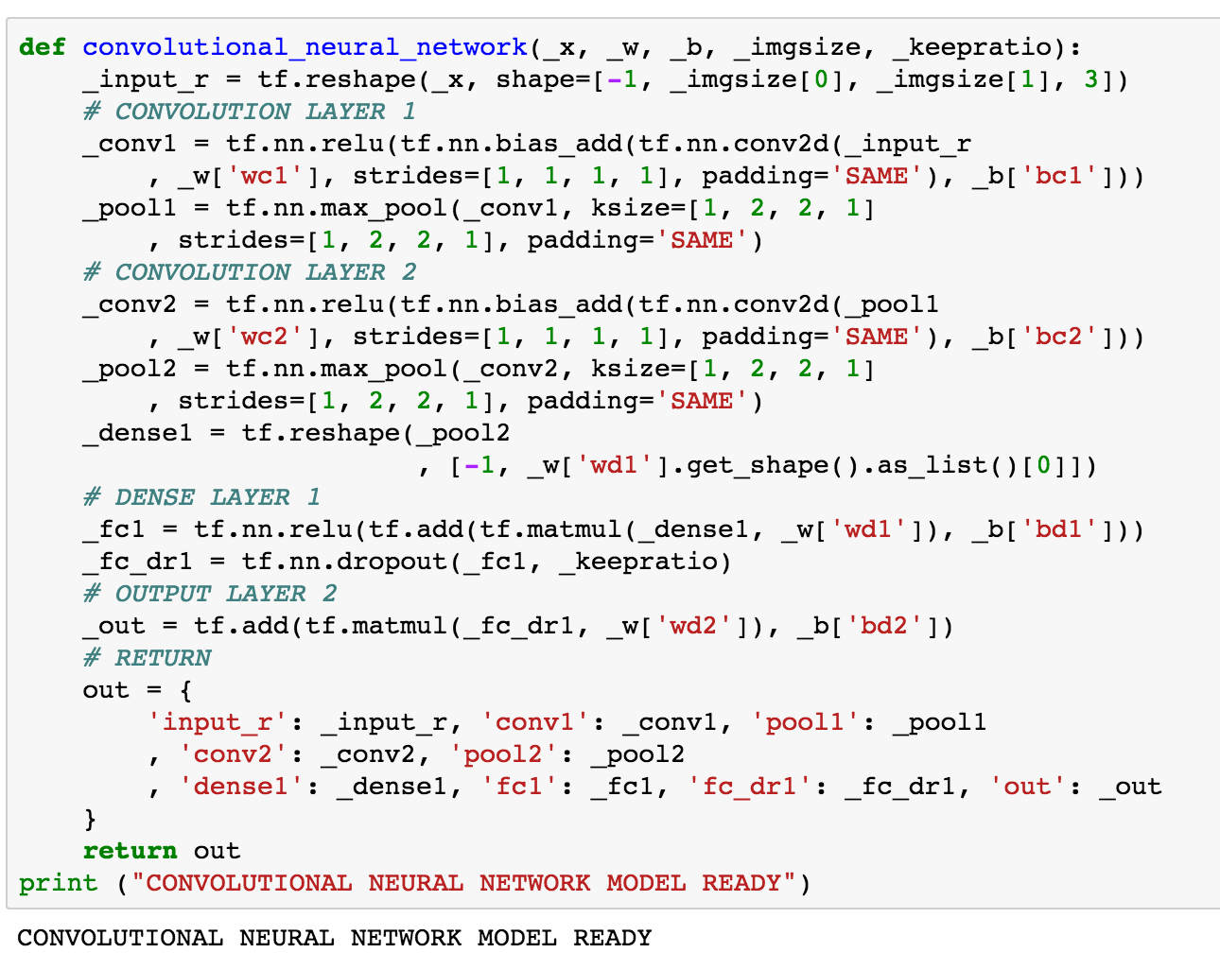
Define CNN model (2/2)

Slide 27
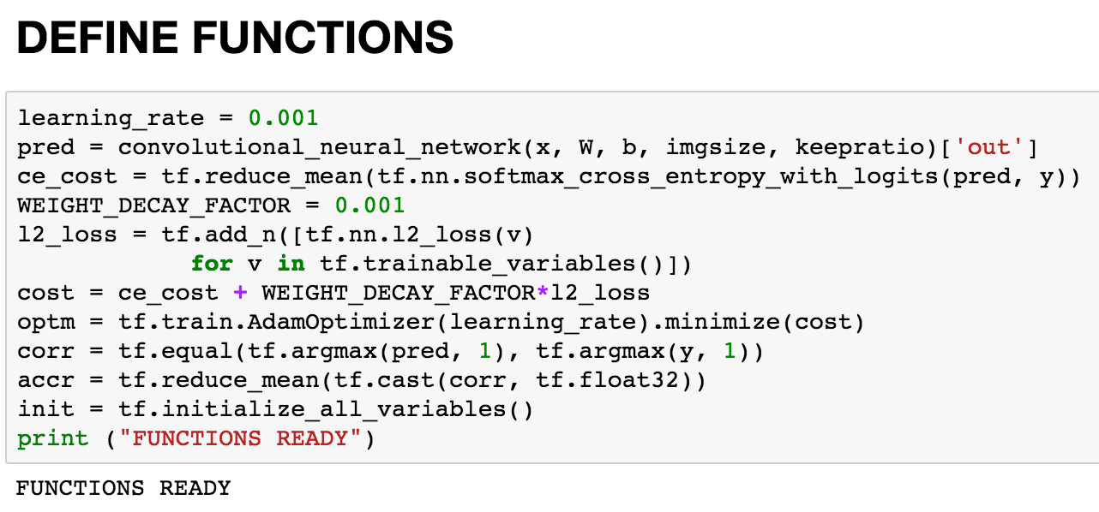
Define functions

Slide 28
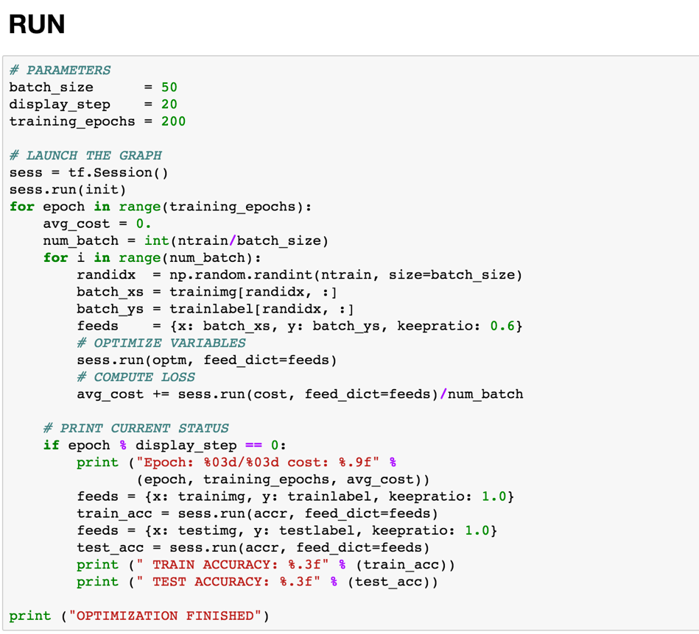
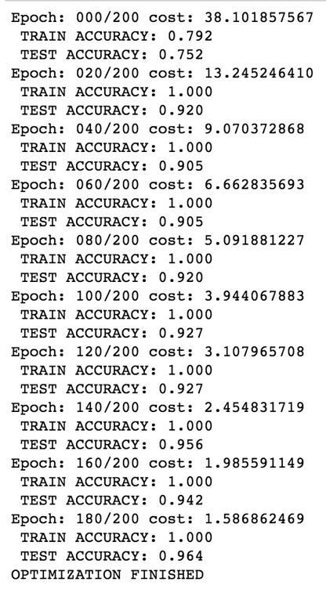
Train the model

Slide 29

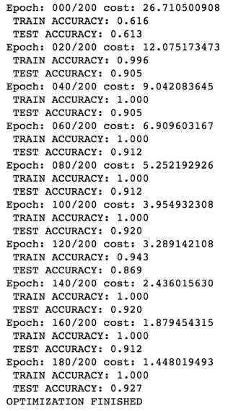
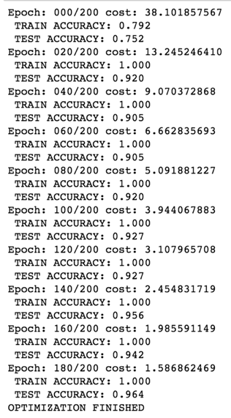
Comparisons

